Slide 1
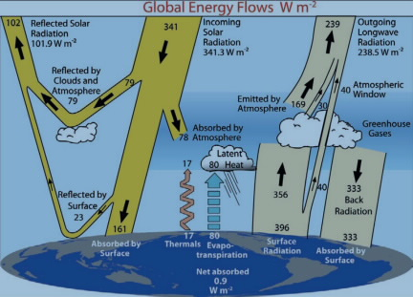
Principle of Energy balance
Basic idea: In steady state, the total Energy coming In to the earth equals the total Energy going Out
Total Energy In = Total Energy Out
This is called the Principle of Energy Balance, and we can use it as a basis of modeling climate (Lab).
See www.cgd.ucar.edu/cas/abstracts/files/kevin1997_1.html

Slide 2
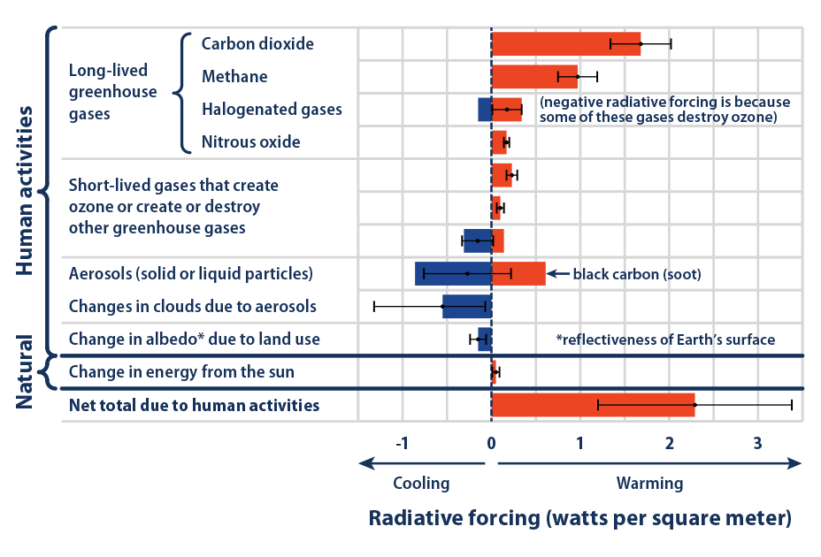

Breakdown of the anthropogenic radiative forcing so far
Anthropogenic forcing so far is $2.6\frac{W}{m^{2}}$, which has led to about a degree (Celsius) warming.

Slide 3
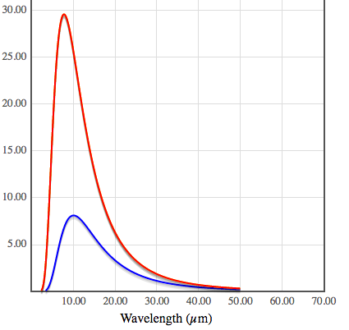
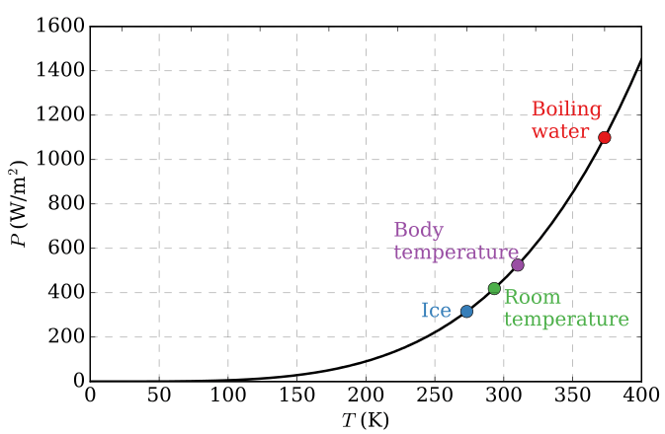

Stefan-Boltzmann
Stefan-Boltzmann power
The Stefan-Boltzmann power is the total energy emitted by each square meter of an object (like the surface of the Earth, or your skin), summed over all the wavelengths.
The overall power of emitted light is given by $σT^{4}$
Stefan-Boltzmann constant: $σ=5.67×10^{−8}\frac{W}{m^{2}K^{4}}$
Temperature has to be in degrees Kelvin: $T\left(K\right)=T\left(℃\right)+273$
https://phet.colorado.edu/sims/html/blackbody-spectrum/latest/blackbody-spectrum_en.html

Slide 4
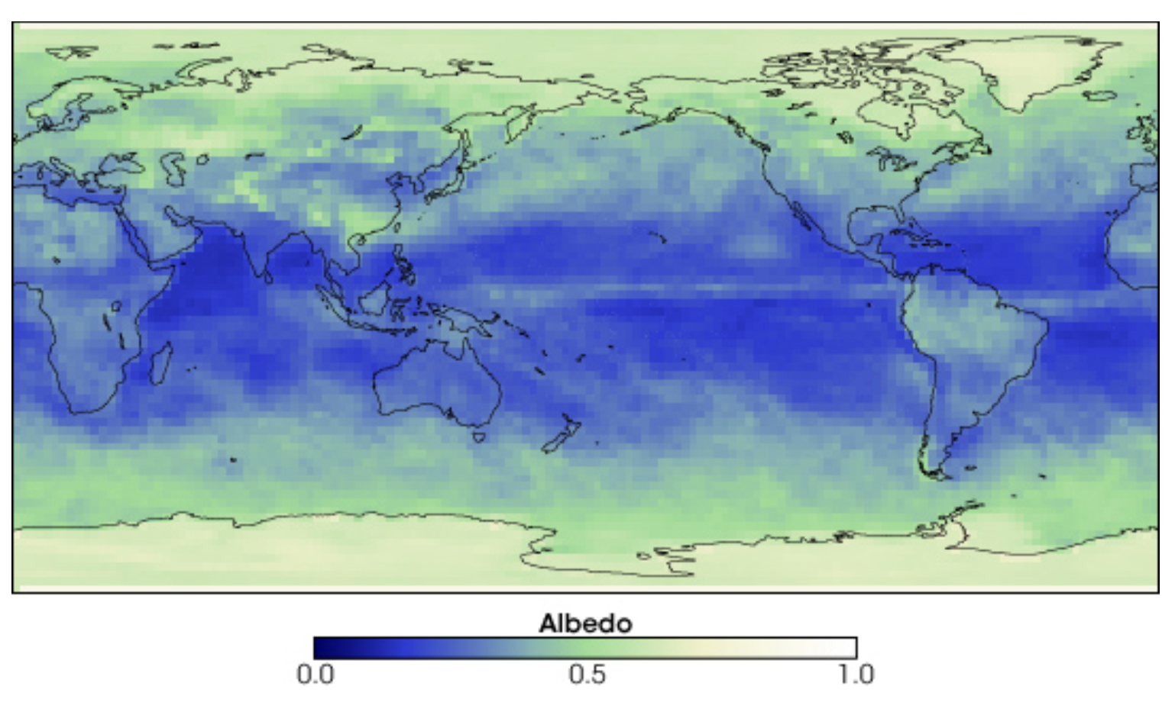
Albedo = Reflectance
These values are the combined result of clouds, land, and ocean, all reflecting sunlight

Slide 5
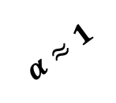
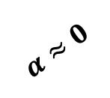
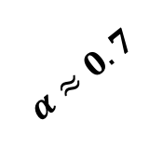
Albedo = Reflectance
Shortwave from the sun
$$α≈0.7$$
$$α≈1$$
$$α≈0$$

Slide 6
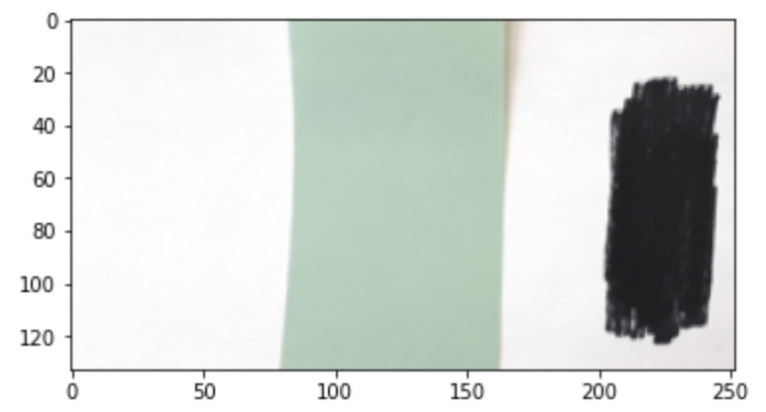
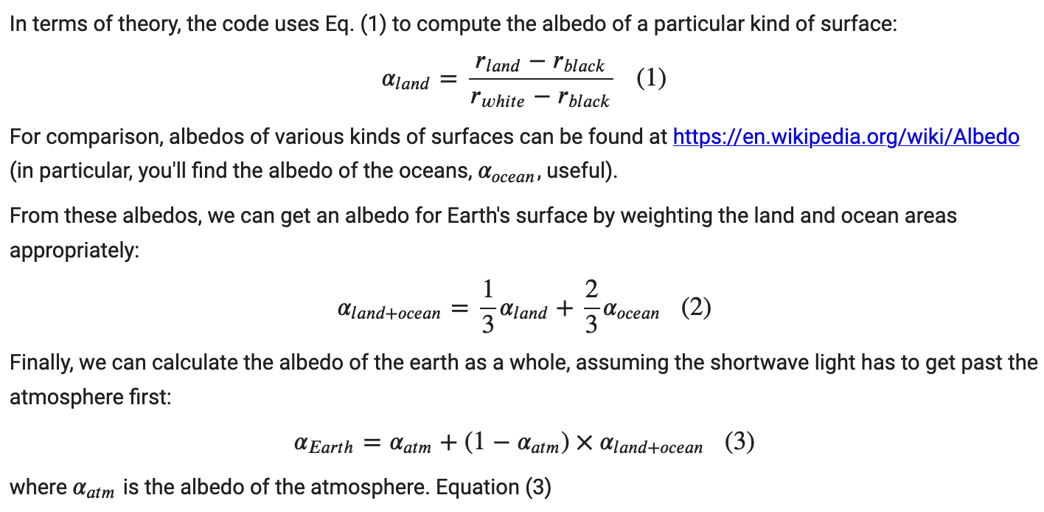
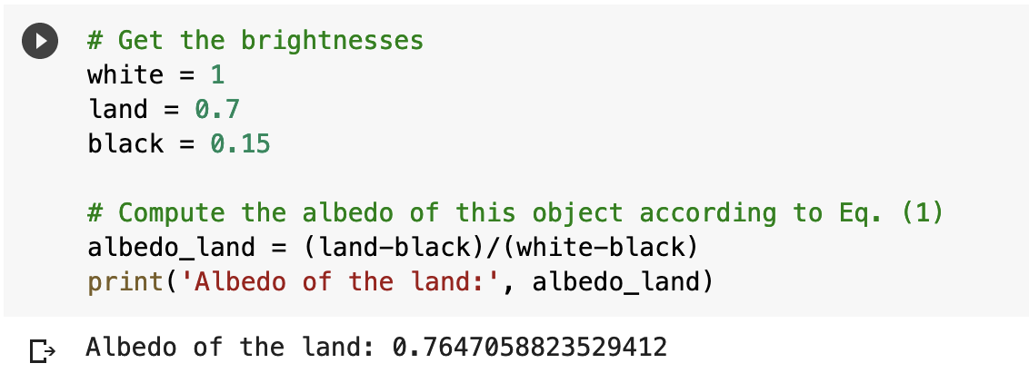
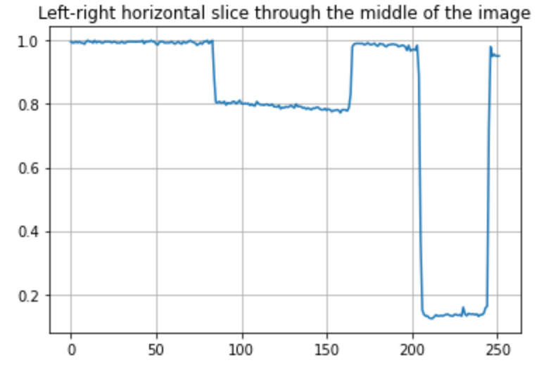
Measuring albedo of a sample surface: Math and Python code

Slide 7
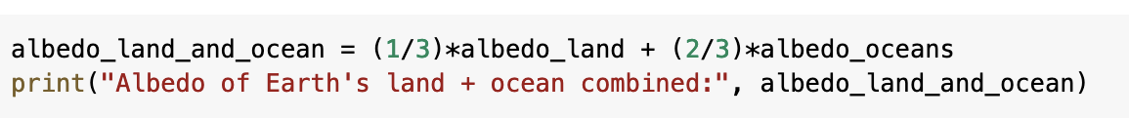


Calculating albedo of land+oceans: Math and Python code
Land albedo ${= α}_{land}=$what you measured
Ocean albedo ${= α}_{ocean} =$0.06

Slide 8

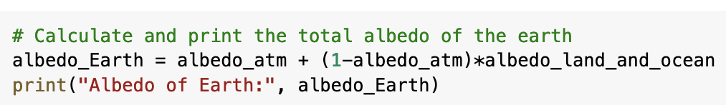
Calculating albedo of Earth as a whole: Math and Python code

Slide 9

Radiative balance – adjusted back to pre-industrial times
$$σT^{4}$$
168
313

Slide 10
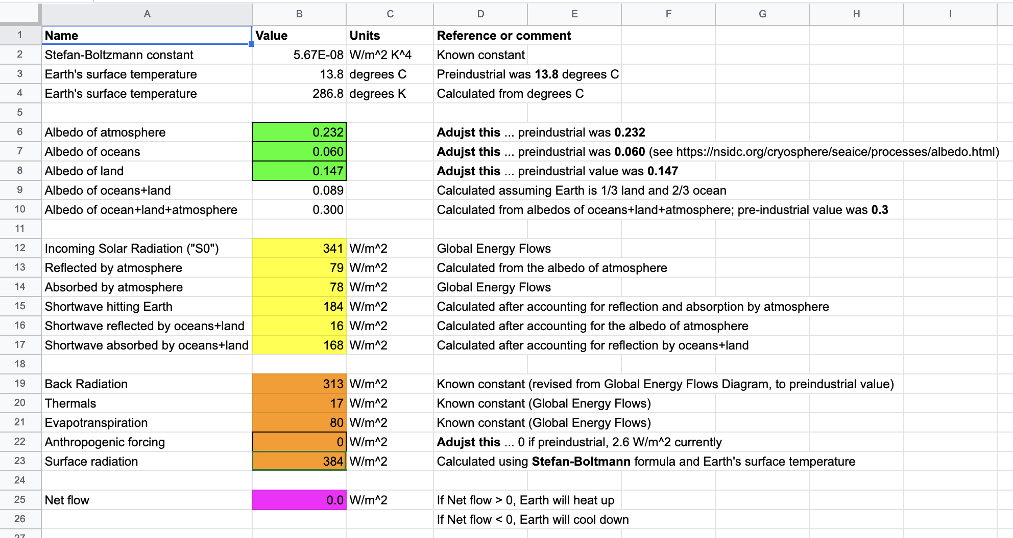
Radiative balance – adjusted back to pre-industrial times

Slide 11
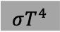
Radiative balance – adjusted back to pre-industrial times
Questions this model can answer for us …
How much will Earth heat up to maintain radiative balance, when the anthropogenic forcing = 2.6 W/m²? More? (did this in lab).
To offset that 2.6 W/m², how much would we need to increase the
albedo of land?
albedo of oceans?
albedo of atmosphere (clouds)?
$$σT^{4}$$
168
313

